Slide 1

Software Design (swD392)
Ch03 – Software Life Cycle Models and Processes

Slide 2
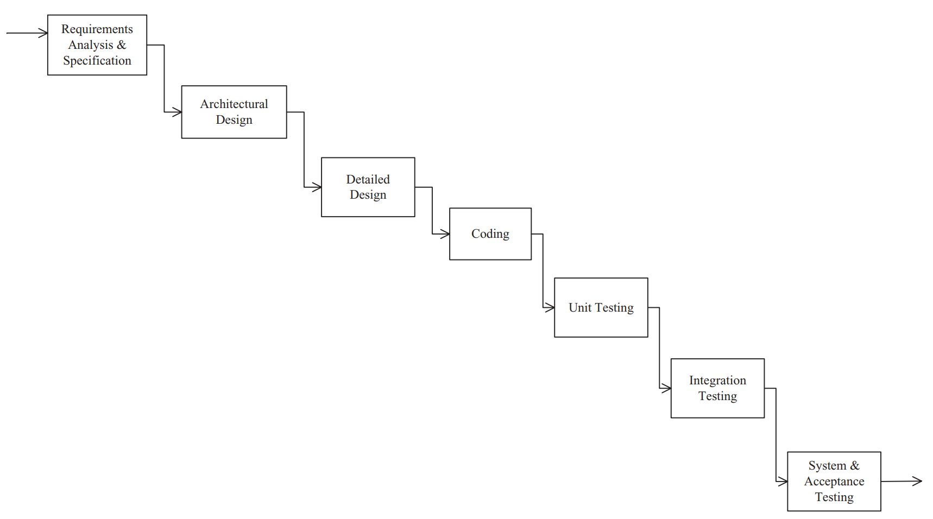
Waterfall Model
Idealized process model in which each phase is completed before the next phase is started, and a project moves from one phase to the next without
iteration or overlap.
Limitations
Does not show iteration in the life cycle
Does not show overlap between phases
Software requirements are tested late in life cycle
Operational system available late in life cycle

Slide 3
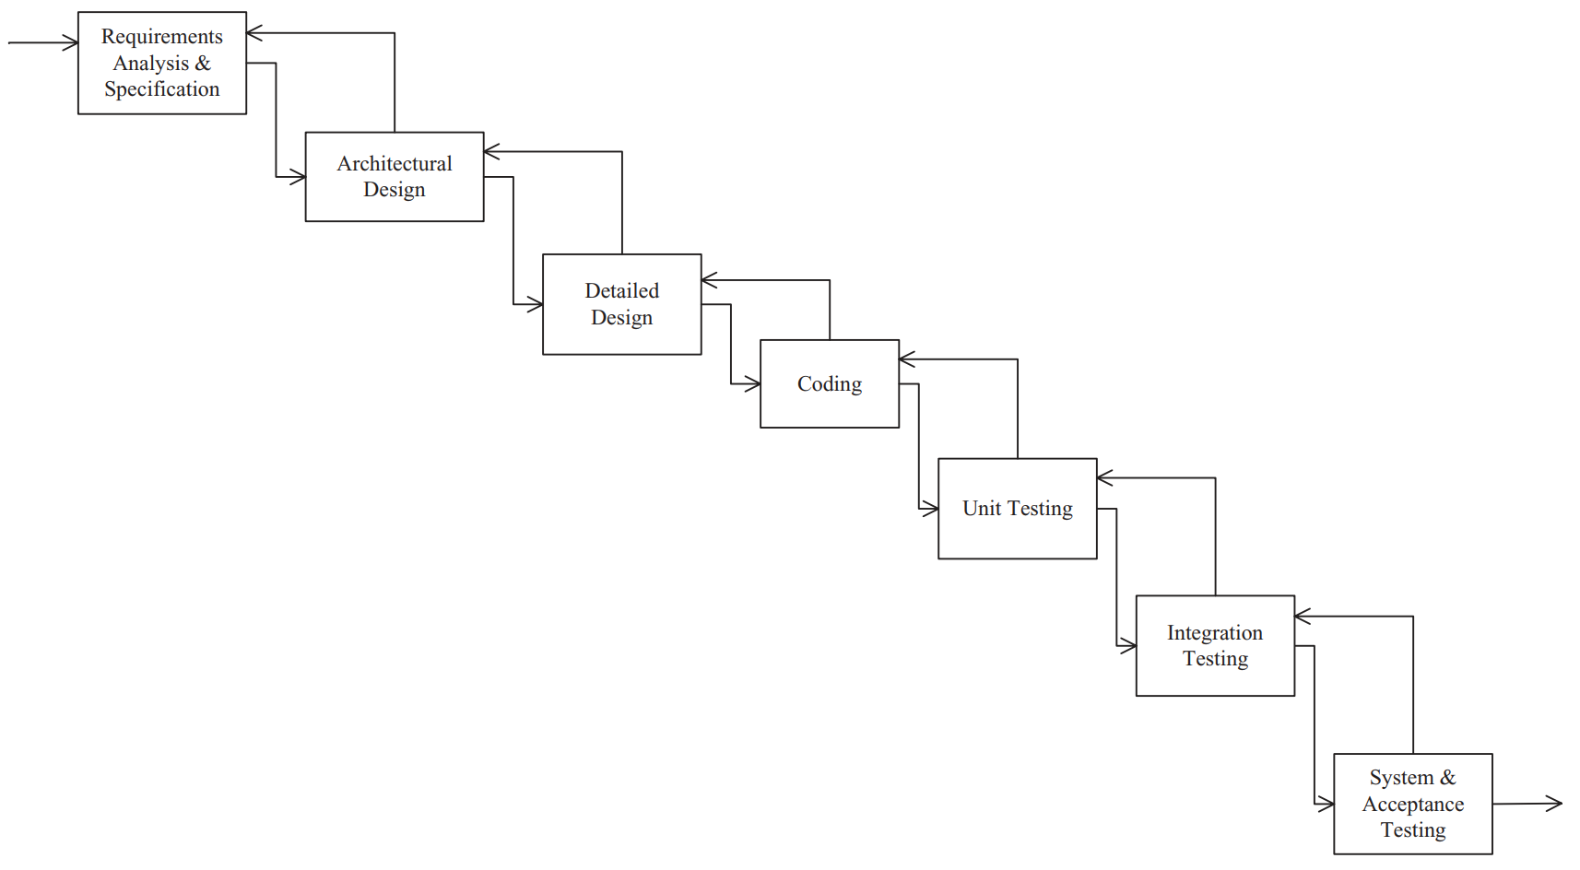
Waterfall Model﻿ Waterfall model with iteration between phases
The waterfall model is a major improvement over the undisciplined approach used on early software projects and has been used successfully on many projects.
In practice, however, some overlap is often necessary between successive phases of the life cycle, as well as some iteration between phases when errors are detected

Slide 4
Throwaway Prototyping﻿ 1/3
Impact of Throwaway prototyping and its revolution
Particularly useful for getting feedback on the User Interface
Is developed after a preliminary requirements specification
Is an effective solution to the problem of specifying the requirements for interactive information system
Helps overcome the communication barrier that existed between the users and the developers
Evolutionary prototyping approach is a form of incremental development in which the prototype evolves through several intermediate operational systems into the delivered system
Evolutionary prototyping approach is to have a subset of the system working early, which is then gradually built on

Slide 5
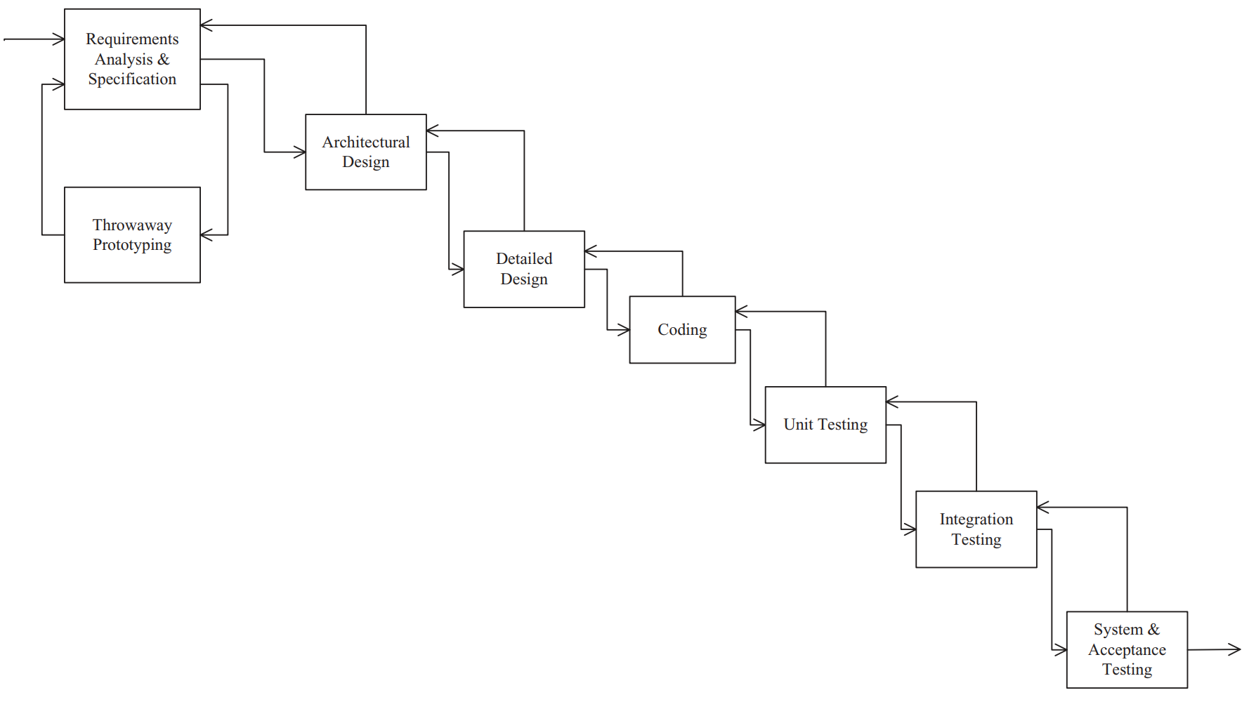
Throwaway Prototyping﻿ 2/3
Throwaway prototyping of requirements

Slide 6
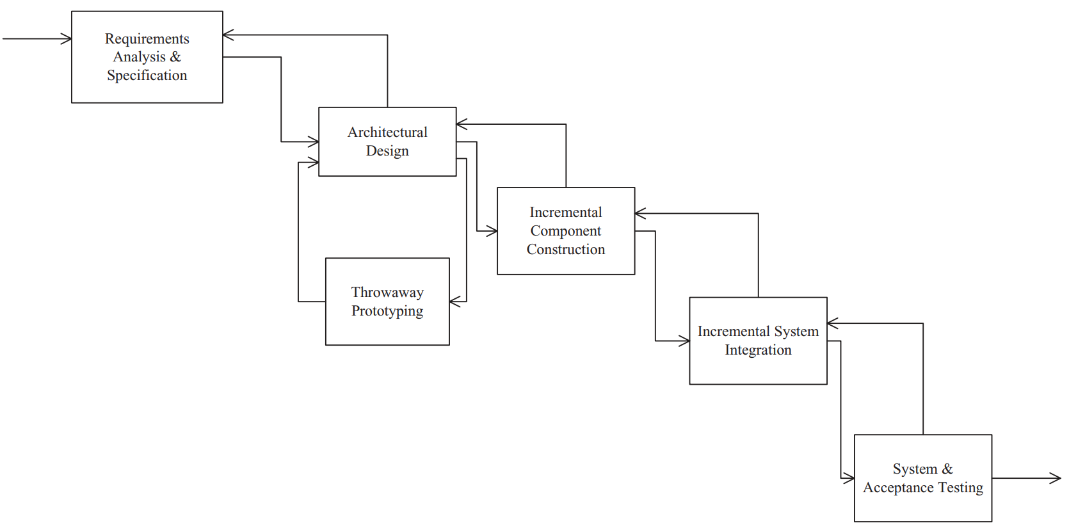
Throwaway Prototyping﻿ 3/3
﻿﻿Throwaway prototyping of architectural design

Slide 7
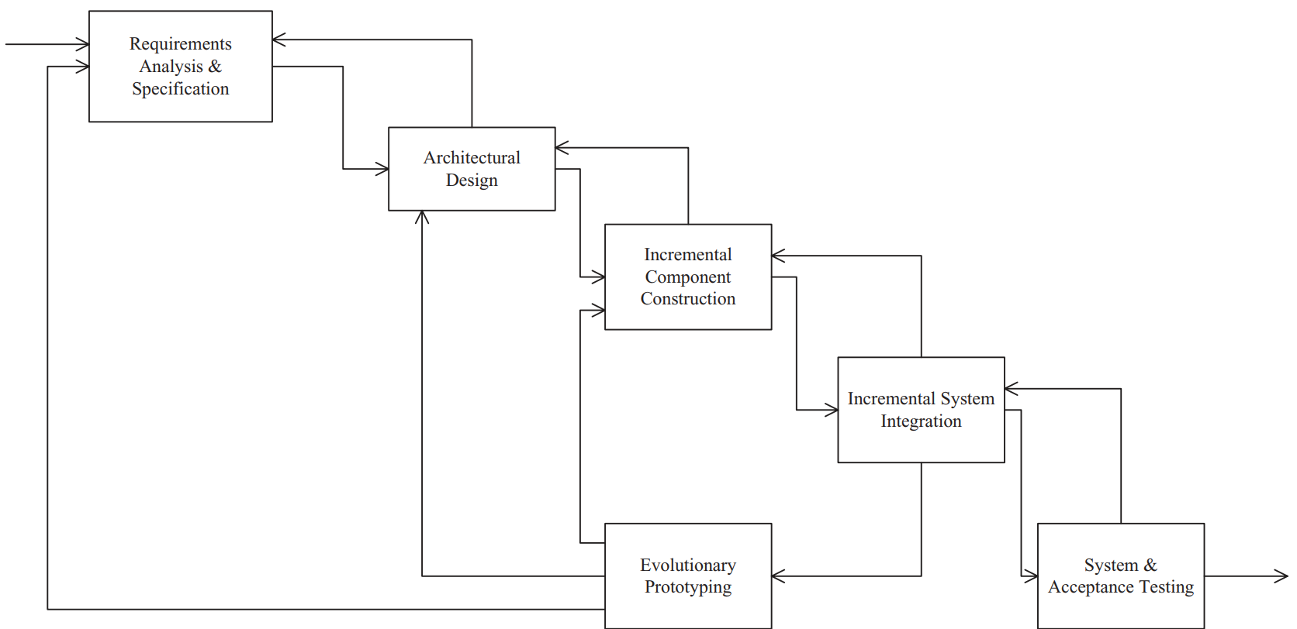
﻿Incremental development model
﻿Evolutionary Prototyping by Incremental Development

Slide 8
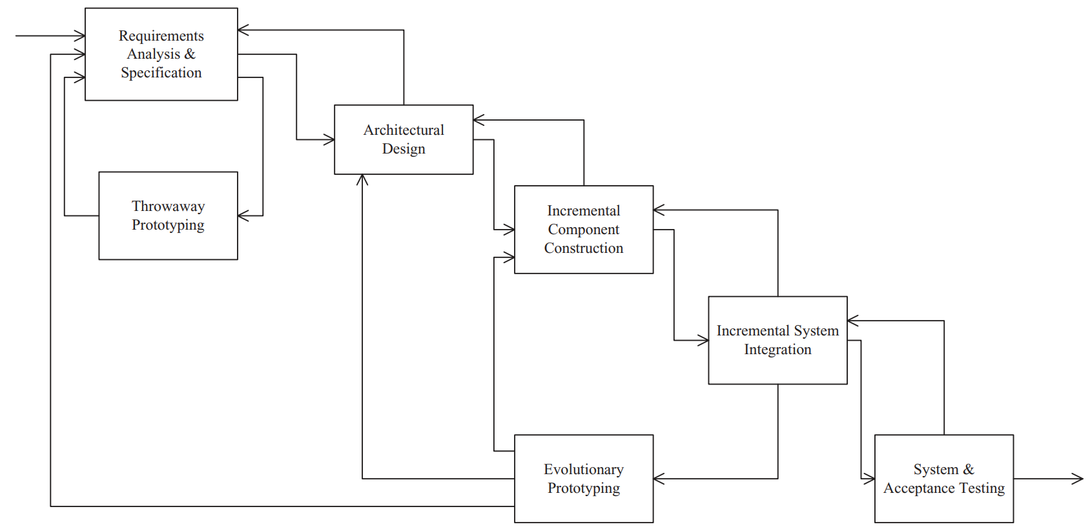
﻿Incremental development model Combine throwaway prototyping

Slide 9
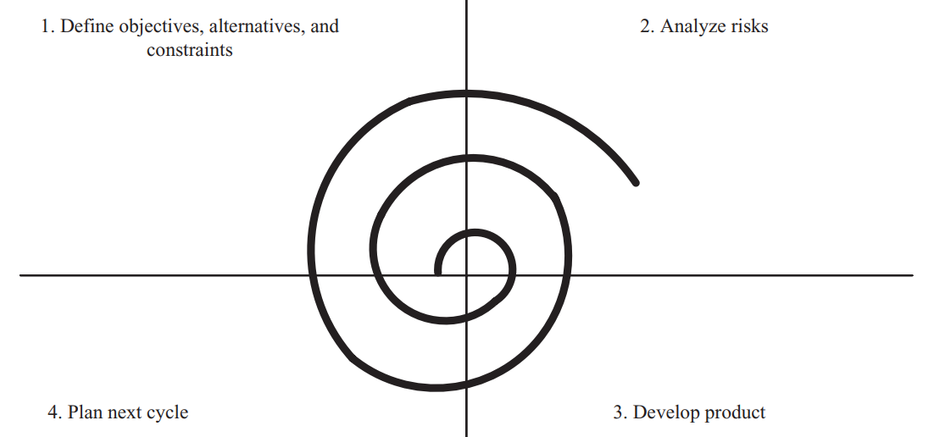
Spiral Process Model (SPM)
Define objectives, alternatives, and constraints. Detailed planning for this cycle: identify goals and alternative approaches to achieving them.
Analyze risks. Detailed assessment of current project risks; plan activities to be performed to alleviate these risks.
Develop product. Work on developing product, such as requirements analysis, design, or coding.
Plan next cycle. Assess progress made on this cycle and start planning for next cycle.
Notes:
Alleviate: xoa dịu

Slide 10
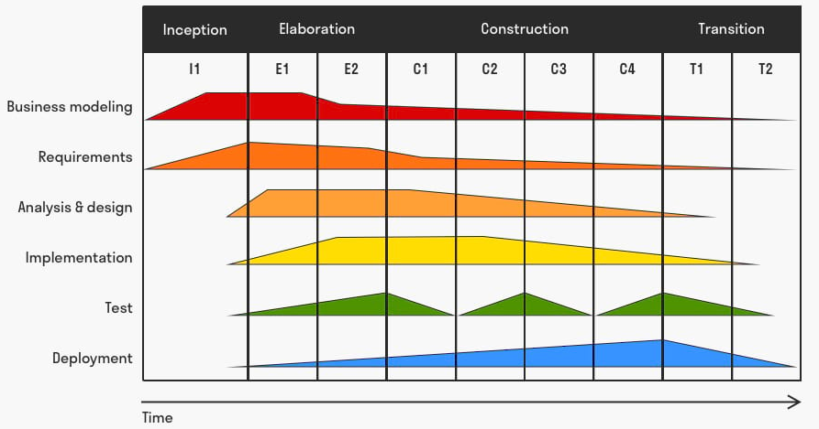
﻿Rational Unified Process (RUP)
AKA ﻿Unified Software Development Process (USDP)
﻿Consists of five core workflows and four iterative phases
Inception: idea, concepts
Elaboration: software architecture
Construction: ready for release to the user community
Transition: the software is turned over to the user community

Slide 11
Design Verification & Validation
﻿The goal of software validation is to ensure that the software development team “builds the right system,” that is, to ensure that the system conforms to the user’s needs.
The goal of software verification is to ensure that the software development team “builds the system right,” that is, to ensure that each phase of the software system is built according to the specification defined in the previous phase.

Slide 12
Design Verification & Validation Verification & Validation Activities
﻿Software Quality Assurance – activities to ensure the quality of the software product
Throwaway prototyping: ﻿validation of the system (before it is developed) against the user requirements
﻿Software technical reviews can help considerably with software verification and validation. In software verification, it is important to ensure that the design conforms to the software requirements specification
﻿Performance Analysis of Software Designs
﻿Analyzing the performance of a software design before implementation is necessary to estimate whether the design will meet its performance goals.
If potential performance problems can be detected early in the life cycle, steps can be taken to overcome them

Slide 13
Software Lifecycle Activities
﻿Requirements Analysis & Specification: BRD/URD => SRS
﻿Architectural Design: ﻿define overall system structures
﻿Detailed Design: define algorithms, internal structures,..
Coding: ﻿each component is coded in the programming language selected for the project
Software Testing
Unit Test
Integration
System Test
AT
Functional testing
Load testing
Stress testing
Volume testing
Carries out by the end users
Tests on individual components
Uses test-coverage criteria
Involves combining tested components into progressively complex grouping

Slide 14


